Slide 1
2024 The 6th IKCEST “the Belt and Road” International Big Data Competition and the 10th Baidu & Xi’an Jiaotong University Big Data Competition
——2024 Challenge: AI commentation for sports events
Team：Vast stars
Speaker：Sha Haiying, Zheng Di, Zheng Yan

Slide 2
ONTENTS
C
1
Team Introduction
2
Competition Question and Task Description
3
Introduction to Preliminary Competition Plan
4
Introduction to the semi-finals plan
5
Introduction to Intelligent Agent Solutions
6
summarize

Slide 3
Team Introduction

Slide 4
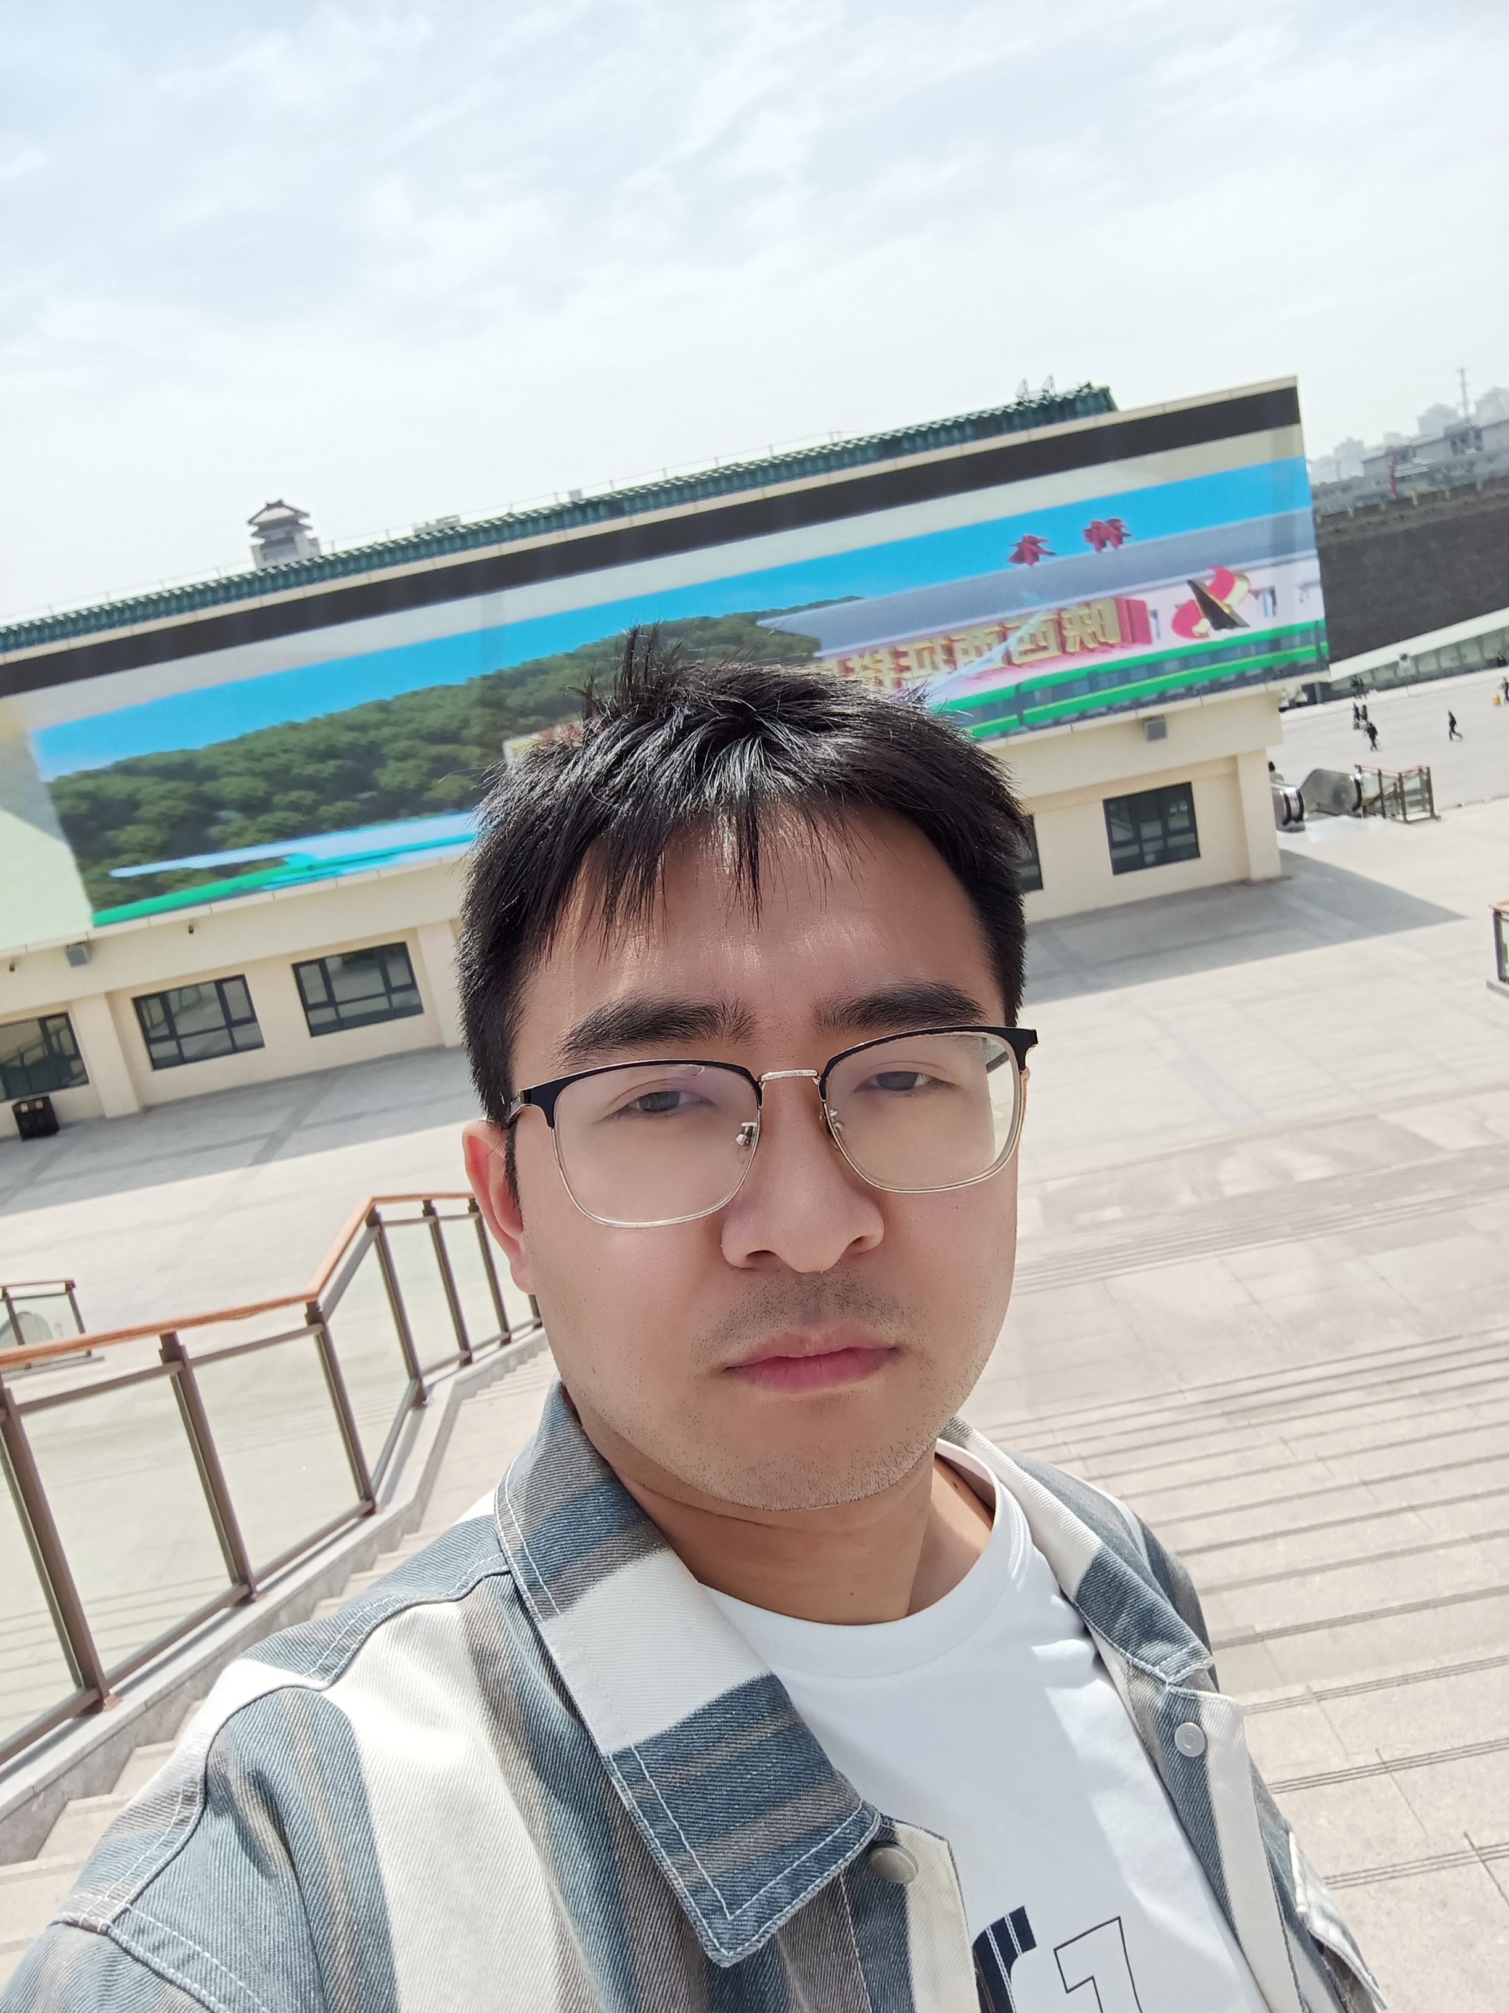
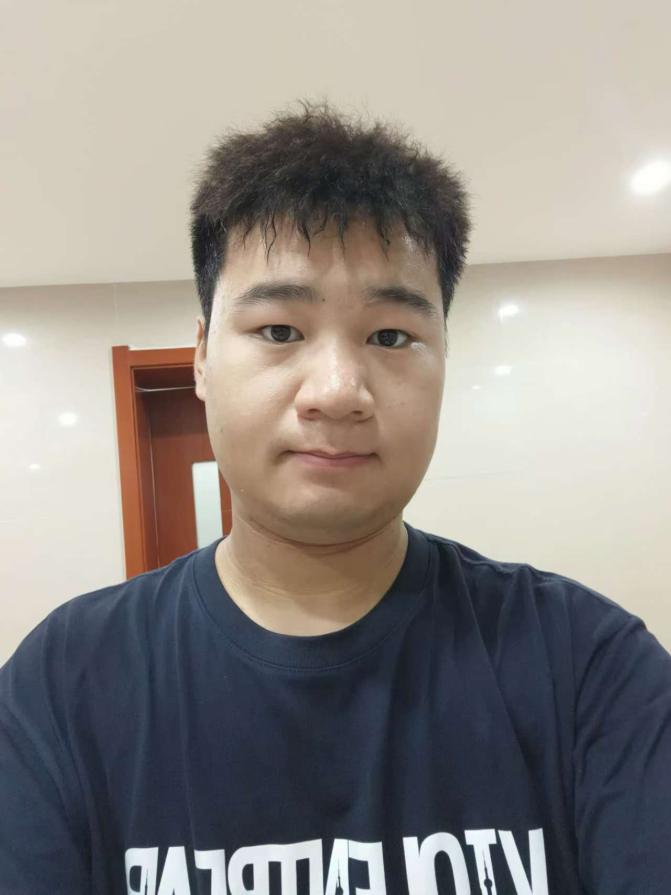
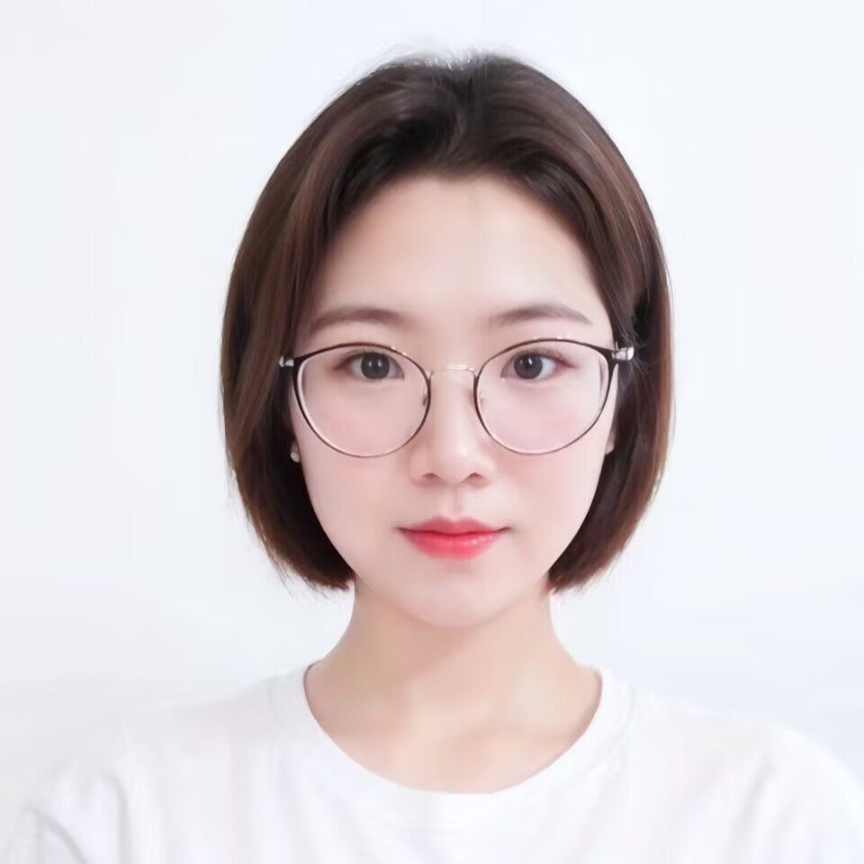
Competition Question and Task Description
Team name：Vast stars
Competition ranking：8
Captain&Team Members
Team Members
Team Members
Graduated from Baoji University of Arts and Sciences in 2017, working as an algorithm engineer with research directions in speech recognition, speech enhancement, diffusion model, CV, etc.
Won the runner up in the vLoong Energy AI Challenge in 2022
Top 11 of the "the Belt and Road" International Big Data Competition in 2023
TOP14 in the Material Science Track of the 2nd World Science Intelligence Competition in 2024
TOP15 Life Science Track of the 2nd World Science Intelligence Competition in 2024
2024 Baidu Business AI Technology Innovation Competition Track 2 Regional Competition TOP7
Undergraduate students of the class of 2025 at Chang'an University, majoring in Internet of Things Engineering. Design an intelligent IoT monitoring system for traffic flow
Multi functional intelligent cabinet, network camera system based on DLIB face detection and DES group encryption algorithm.
Graduated from Baoji University of Arts and Sciences in 2019, with a passion for AI generation and short video creation.

Slide 5
Competition Question and Task Description

Slide 6
Competition Question and Task Description
Competition Question
AI commentation for sports events
background
With the development of artificial intelligence technology, its application in sports events is becoming increasingly widespread, especially in automated video analysis and event commentary. The ultimate goal of this competition is to promote the practical application of AI in the field of sports, explore how AI technology can enhance the viewing experience of sports events, and improve the dissemination and understanding of events through technological innovation.
Task Description
The purpose of this competition is to challenge participants to use computer vision technology to conduct in-depth analysis of dynamic images through sports competition videos, combined with big language models, natural language processing, speech generation and other technologies, and generate event commentary through the design of big model intelligent agents/plugins. Through this technological challenge, participants will have the opportunity to showcase their skills in video processing, object recognition and tracking, big language modeling, and other areas, driving advancements in sports video analysis technology.

Slide 7
Overall plan
Enter football match:URL
agent
LLM
Preliminary round: Multi target tracking
Finals: jersey identification
Post processing
Output: AI sports event commentary

Slide 8
Introduction to Preliminary Competition Plan

Slide 9
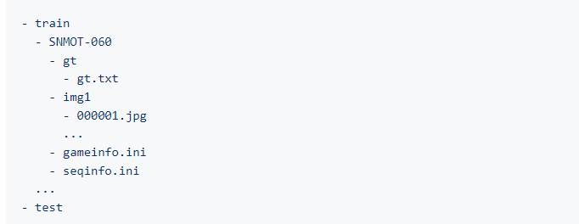
Preliminary dataset and task analysis
Dataset:
The competition provides multiple standard 720P high-definition football match video data, which are provided in the format of. jpg frames after video splitting. The average video length is 750 frames.
Dataset structure:
Task analysis:
This problem belongs to a multi-target tracking task, which requires detecting the coordinate information and IDs of football and players.
Reference project：https://aistudio.baidu.com/projectdetail/4350452
Dataset：https://aistudio.baidu.com/datasetdetail/272560

Slide 10
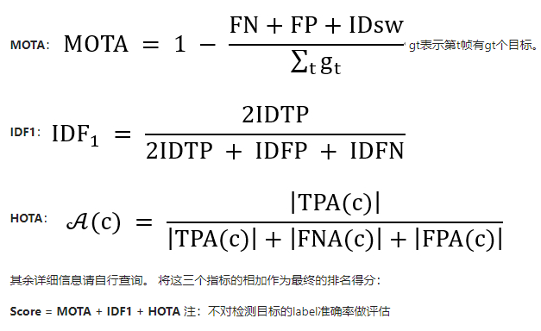
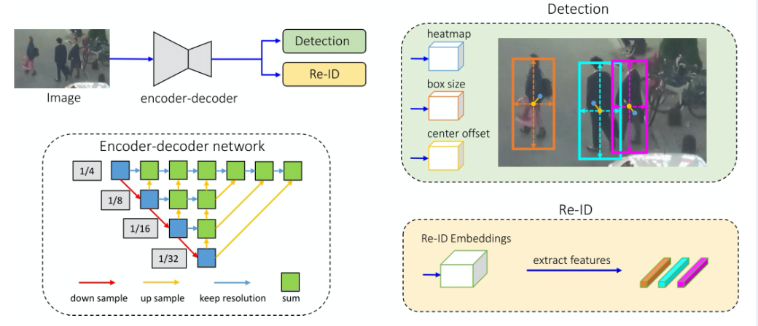
Preliminary Scheme Selection 1
Baseline介绍
The basleline uses the multi-target tracking model provided in the PaddleDetection library to achieve this task, with a main structure of DLA34+JDE.
model | Score
baseline | epoch20/0.7118
baseline+warmup | epoch25/1.00844
hrnetv2 | epoch6/1.08139
I tried on the Baseline and found that the improvement was not very significant, and there may have been insufficient validation. Therefore, I decided to adopt the Pytorch scheme to achieve multi-target tracking.

Slide 11
Preliminary Scheme Selection 2
The training of the scheme is based on Baseline -->Yolov8-->Deep IoU, and the multi-target detection performance is improved to 2.18446.
模型 | 性能
paddle baseline+warmup | 1.00844
paddle hrnetv2 | 1.08139
Pytorch directly uses pre trained model model.track with default parameters | yolov8n.pt 1.36311 yolov8x.pt 1.78794 rt-detrx.pt 1.74127
Pytorch uses pre trained model yolov8x.pt to train 228 classification model in 15 steps | 1.56787
Pytorch uses pre trained model yolov8x.pt to train 2 classification models, epoch=8 | epoch=8 1.92114 epoch=10 1.95342 epoch=14 1.98322 epoch=29 2.03259( GSI 2.03388 AFLink 2.05314)
Pytorch uses pre trained model yolov8x.pt to train 2 classification models, epoch=34 | 2.04334 GSI+AFLink 2.06284 epoch=68 2.05447
Pytorch uses pre trained model yolov8x.pt to train 2 classification models, epoch=8+aug | 2.00683 GSI+AFLink 2.02679 epoch=10 2.01647 epoch=25 2.07129 GSI+AFLink 2.08958 epoch=33 2.07407
Pytorch uses pre trained models https://github.com/hsiangwei0903/Deep-EIoU+ track_buffer=50 | Using pre trained models 2.14578 GSI+AFLink 2.15386
Pytorch uses pre trained models https://github.com/hsiangwei0903/Deep-EIoU + track_buffer=300 | Using pre trained models 2.1759 GSI+AFLink 2.18171
Deep-EIoU +Replace reid withclip-reid Market1501_clipreid_ViT-B-16_60.pth | Using pre trained models 2.18009 GSI+AFLink 2.18446

Slide 12
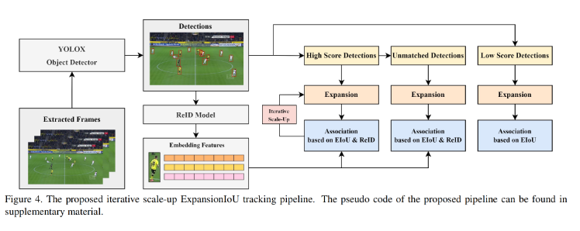
Scheme Introduction
Model Architecture--Deep-EIoU
Firstly, apply the object detector YOLOX on each input frame, and then associate based on several clues such as the similarity between extracted appearance features and the ExpansionIoU between small trajectories and detections. After obtaining the correlation loss, the Hungarian algorithm is used to obtain the best match between the small trajectory and the detection.
reference resources：
https://blog.csdn.net/dally2/article/details/135777792
https://github.com/hsiangwei0903/Deep-EIoU

Slide 13
Scheme Introduction
Model scheme modification points and their advantages and disadvantages
Modification point:
Pre trained model: The performance of the pre trained model reached 2.14578, so further training of the model was not performed.
ReID model: Deep IoU multi-target tracking uses YOLOX+ReID for tracking. Therefore, it is considered to replace the pedestrian re identification model in the scheme with CLIP ReID method. ReID adopts Market1501_clipreid_ViT-B-16_60.pth, and the model performance is improved by 0.03, reaching 2.18009.
Post processing techniques: In the StrongSORT scheme for target tracking, it is mentioned that AFLink (Global Linking Method) and GSI (Gaussian Process Interpolation of Detection Error) can be seamlessly integrated into the tracking results. Extracting AFLink+GSI and referencing it in the model can improve the performance to 2.18446.
advantage:
Only the model of the AFLink module needs to be trained, and all other models can be found on GitHub to achieve good performance.
Disadvantages:
Due to the lack of football detection in the analysis of multi-target tracking systems, training will be conducted in the semi-finals, and the football detection model will also be embedded into the multi-target tracking system.
https://blog.csdn.net/matt45m/article/details/137286011
https://github.com/dyhBUPT/StrongSORT/tree/master
https://github.com/Syliz517/CLIP-ReID
https://github.com/ylm1379239710/YOLOv8-PySide6-CLIP-REID

Slide 14
Introduction to the semi-finals plan

Slide 15
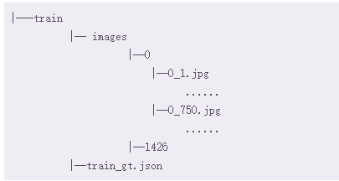
Introduction to the semi-finals plan
Dataset analysis:
Under images are all the image folders, each folder storing images of the same player at different times. It is worth noting that not every image can clearly show the jersey number
Train_gt.json stores labels in the form of a dictionary, assigning a unique jersey number to each folder. If all the images in a folder cannot see the jersey number clearly, it will be labeled as -1
Task analysis:
In the preliminary round, our task was to track the players in the video and successfully box the targets. The semi-final task is a continuation of the preliminary round task, which is to identify the jersey numbers of the selected players and confirm their identities Belonging to OCR tasks.
Dataset:https://aistudio.baidu.com/datasetdetail/291145

Slide 16
Introduction to the semi-finals plan
The plan adopts a constantly evolving approach, starting from CnOcr ->CnOcr ->PaddleOCR ->Soccernet Jessey Number OCR. The performance of the jersey number recognition model on the Soccernet Jessey Number OCR was ultimately achieved on the test set 0.81748。
model | score | score_neg | score_pos
All for-1 | 0.10306 | 0.34352 | 0
easyocr | 0.26888 | 0.45252 | 0.19018
CnOcr | 0.58959 | 0.56647 | 0.5995
PaddleOCR（Default configuration） | 0.47593 | 0.60198 | 0.42191
easyocr+yolov8m-pose.pt | 0.56477 | 0.66887 | 0.52015
Jersey-Number+yolov8m-pose.pt | 0.81061 | 0.81833 | 0.8073
Jersey-Number+easy_ViTPose | 0.81748 | 0.80595 | 0.82242
https://github.com/Rohitkushwaha79/Soccernet-Jersey-Number-OCR

Slide 17
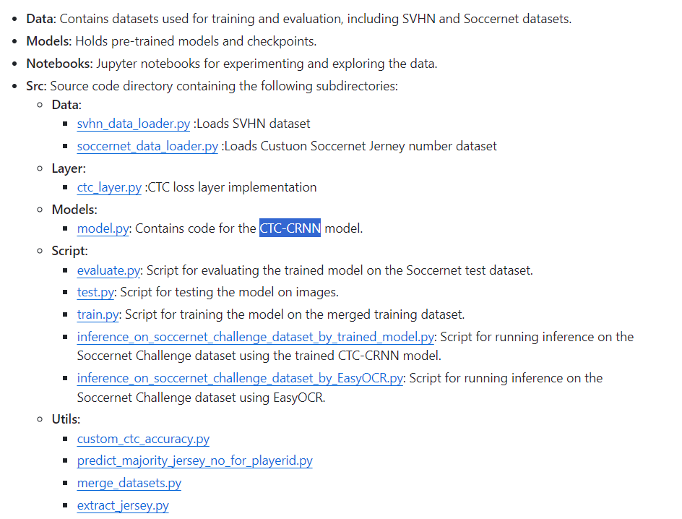
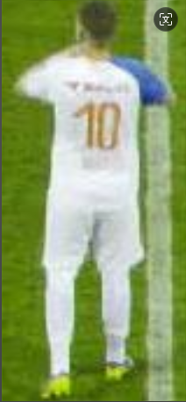
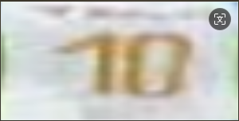
Introduction to the semi-finals plan
Jersey identification Soccernet-Jersey-Number-OCR scheme introduction
Attitude recognition
yolov8m-pose.pt
easy_ViTPose
10
OCR model
CTC-CRNN
参考：
https://github.com/Rohitkushwaha79/Soccernet-Jersey-Number-OCR
https://github.com/JunkyByte/easy_ViTPose
https://github.com/ultralytics/ultralytics

Slide 18
Introduction to the semi-finals plan-Supplement football detection model
Due to the lack of detection of football in the target tracking in the preliminary scheme, the YOLOV8_p2 structure is adopted to preprocess the preliminary data and only filter out the categories of football to train the football detection model.
model | metrics/precision(B) | metrics/recall(B) | metrics/mAP50(B) | metrics/mAP50-95(B)
YOLOV8+epoch20 | 0.636 | 0.418 | 0.429 | 0.179
YOLOV8+epoch40 | 0.654 | 0.428 | 0.448 | 0.193
YOLOV8_p2+epoch20+aug | 0.74412 | 0.66088 | 0.68443 | 0.32853
YOLOV8_p2+epoch28 +noaug | 0.77 | 0.678 | 0.734 | 0.374
YOLOV8_p2+epoch68+noaug | 0.78581 | 0.69998 | 0.77321 | 0.41235

Slide 19
Introduction to Intelligent Agent Solutions

Slide 20
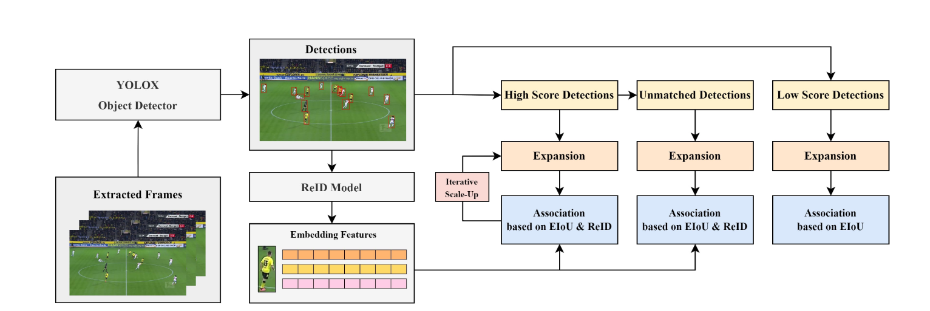
Introduction to Intelligent Agent Solutions
Intelligent agent production steps:
1. Each model inherits into a system
Input: Video
Output: Competition information
2. Deploy the subsystem obtained from 1 as a service and return game information through POST request
Input: URL link
Output: Competition information
3. Production workflow
4. Creating intelligent agents
5. Translate the explanatory document and merge it with audio and video
OCR Jersey inspection
Post processing generationprompt
Flask Services
YOLOV8 Football detection
URL
Agent

Slide 21

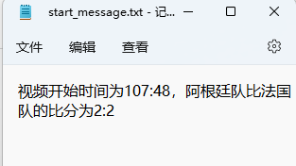
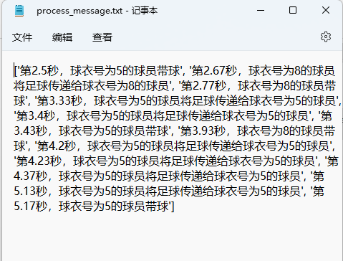
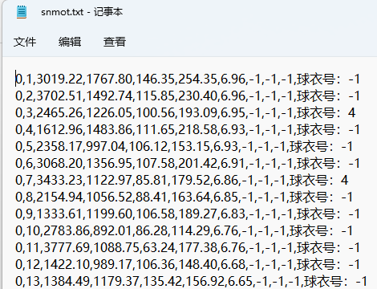
Introduction to Intelligent Agent Solutions
Competition information
1. Each model inherits into a system
a. Add CNOCR to identify match team information and time
b. Add goal recognition and team recognition
c. Add post-processing code to supplement critical events
Competition informationOCR
Multi object tracking+football detection
Football
Football and player distance
Distance less than 50 pixels
Player passes the ball
gloabl Jersey number
Frame team (if the other team has more than 3 players, they will break through)
Pass and dribble the ball by yourself
Judging shots and goals based on the position of the goal and goalkeeper

Slide 22
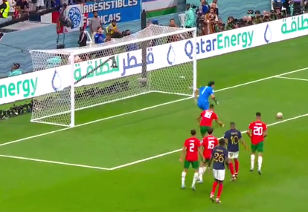
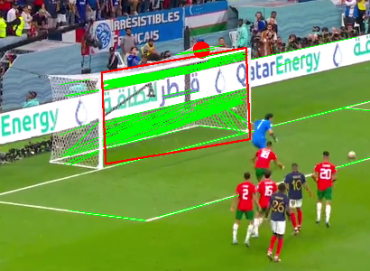
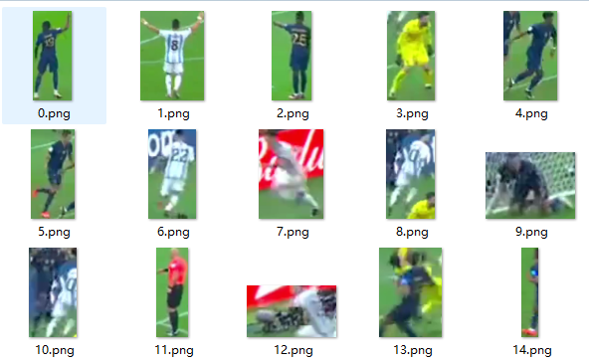
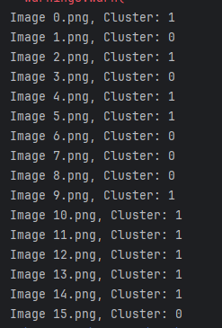
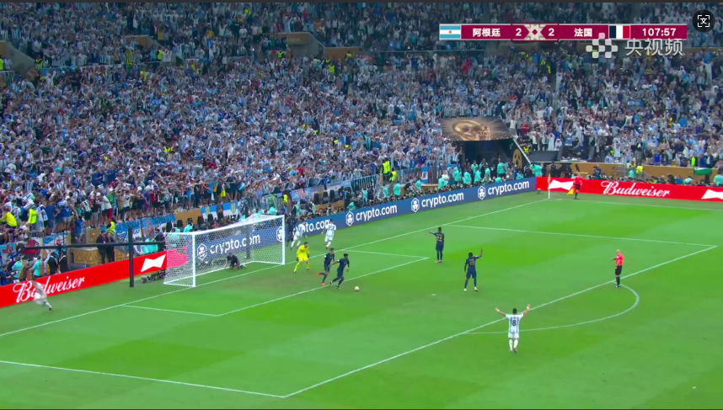
Introduction to Intelligent Agent Solutions
1. Each model inherits into a system
Goal recognition and team recognition
edge detection
Hough transform for detecting straight lines
The most densely populated area of line segment center points
KMeansCluster to find the densest region
Threshold for the number of straight lines to determine the presence of a goal
Draw an inscribed rectangle at the center points of all lines to obtain four corner points
Select parallel lines and draw a quadrilateral based on the slope
object detection
KMeans divides teams based on image color features

Slide 23
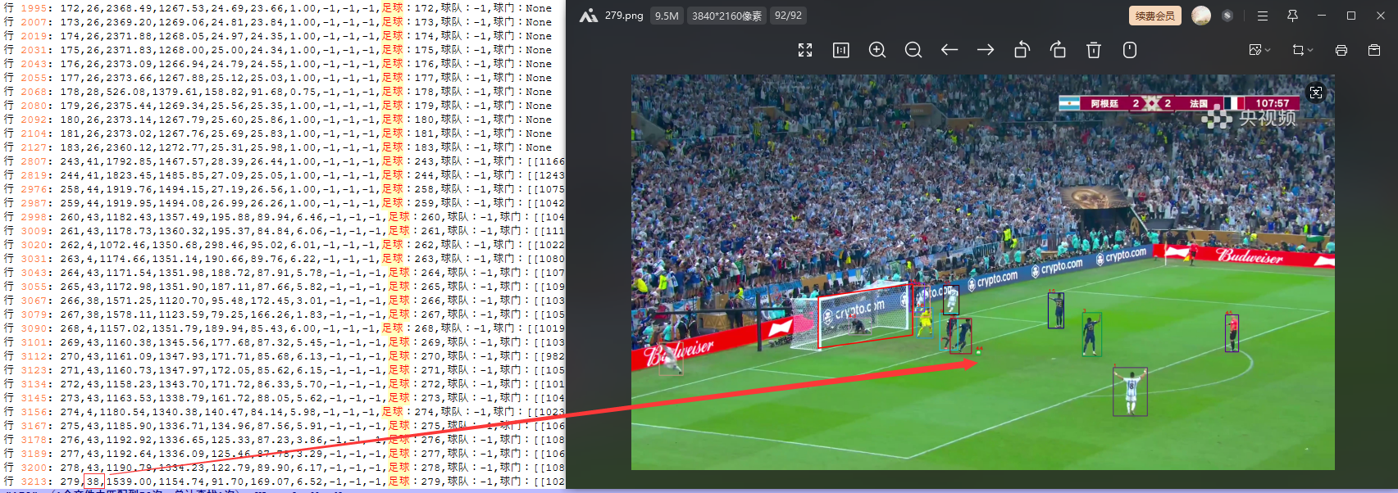
Introduction to Intelligent Agent Solutions
1. Each model inherits into a system
Problem discovery and improvement:
Putting football detection into the entire tracking system will cause changes in the football ID to some extent, which will slightly affect the performance of the system. Therefore, football tracking will not be carried out.

Slide 24
Introduction to Intelligent Agent Solutions
2. Deploy the subsystem obtained from 1 as a service and request it through POST
Model deployment: Deploy the video commentary system as a service using the Flask framework, and then call it through post requests.
Model deployment platform: https://www.deepln.com/#/ ,
Resources: GPU RTX-3060 VRAM: 12GB CPU cores: 56 cores (relatively few)
Lightweight OCR and tracking model deployment (default models with relatively large specifications)
Replacing the tracking model osnet-x1_0 with Market1501_clipreid_ViT-B-16_60.pth can improve performance to some extent, but the number of parameters will increase, resulting in an increase in inference time.
Replacing the posture detection model yolov5m-pose with easyViTPose has some improvement in performance, but the number of parameters will increase, resulting in an increase in inference time.
Replacement method:
Annotate CLIPReIDModel in Deep-EIoU\reid\torchreid\utils\feature_extractor.py to use the osnet-x1_0 model for tracking.
By changing the pose type parameter to yolov8m pose in Soccernet-Jersey-Number-OCR-main\image_inference_by_trained_model.py, one can use yolov8m pose for pose estimation.

Slide 25
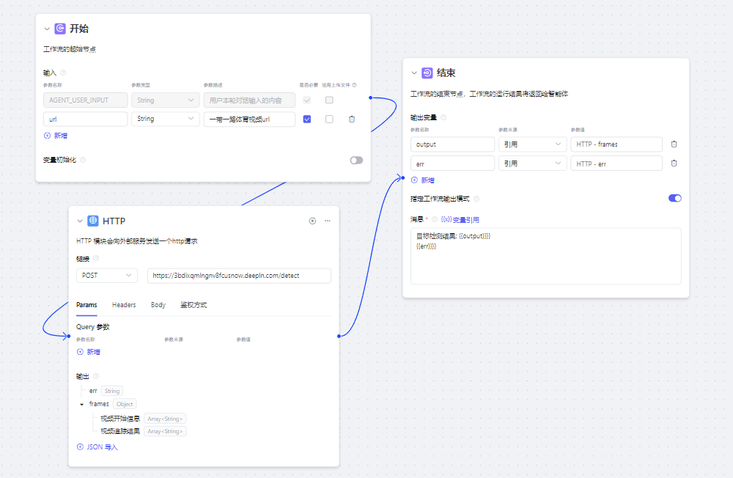
Introduction to Intelligent Agent Solutions
3. Production workflow

Slide 26
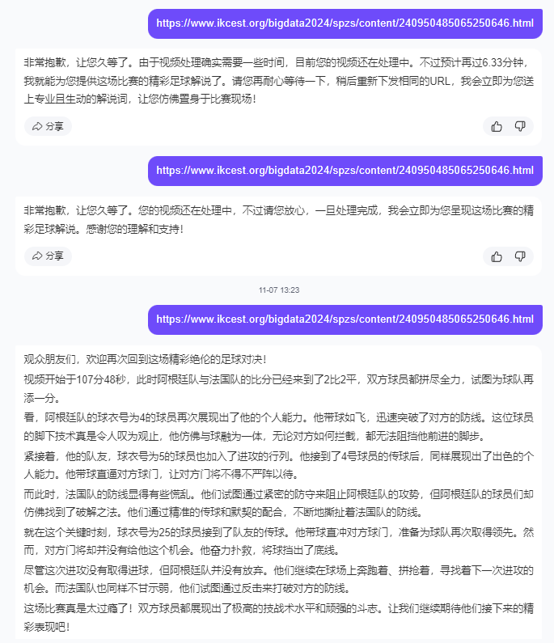
Introduction to Intelligent Agent Solutions
4. Creating intelligent agents
Due to the fact that the entire system for sports event commentary takes approximately 0.8 minutes to process a 1-second video, an 11 second video takes about 7 minutes, and the session of the intelligent agent currently only takes 120 seconds to time out. Sending a URL once does not meet the requirement of receiving commentary information. Therefore, by issuing the same URL twice, the user can receive explanatory information (if it is not processed completely, the user will be prompted to wait, and if a different URL is issued after processing is completed, new processing will be performed)

Slide 27
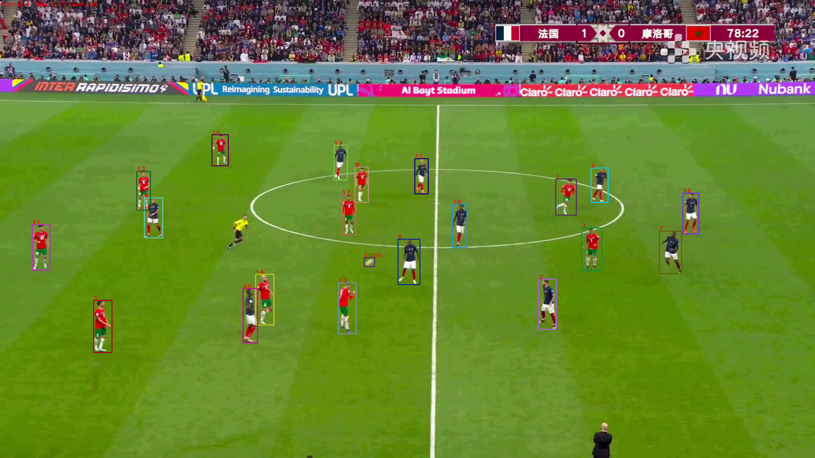
Introduction to Intelligent Agent Solutions
5. Translate the explanatory document and merge it with audio and video
1) Call edge_tts to generate speech based on the commentary
2) Extend video duration to match voice length
3) Call ffmpeg to merge voice and video
Linux subtitle synthesis error, can be synthesized using Windows. Windows can use "Synthesize. bat" to synthesize videos, simply replace the video caption text. txt and a4.mp4 with the URL video and caption.

Slide 28
summarize

Slide 29
summarize
Contribution points
Integrating multi-target tracking, pose recognition, OCR model, goal recognition, and team recognition into one system, by issuing football match URLs to the intelligent agent, corresponding football video game commentary can be obtained.
shortcoming
1. The commentary did not clearly distinguish between the home and away football teams;
2. The performance of the football goal recognition model is relatively poor at long distances;
3. The performance of the football detection model is still not good enough, and it is relatively poor during high-speed football movement;
The biggest drawback of commentary is that shots and goals are not detected. Although there is goal detection, the football detection effect is not very good, and goals cannot be detected.
5. The audio and video of the commentary document were merged, but due to the longer audio compared to the video, the effect needs improvement and was not embedded in the intelligent agent;

Slide 30
references
Reference paper/open source solution
[1] Hsiang-Wei Huang1, Cheng-Yen Yang1, Jiacheng Sun1, Pyong-Kun Kim2Kwang-Ju Kim2, Kyoungoh Lee2, Chung-I Huang3, Jenq-Neng Hwang1.Iterative Scale-Up ExpansionIoU and Deep Features Association forMulti-Object Tracking in Sports[J],2023.
[2] Siyuan Li,1 Li Sun,1,2 * Qingli Li1CLIP-ReID: Exploiting Vision-Language Model for Image Re-Identification without Concrete Text Labels[J],2022.
[3] Yunhao Du, Zhicheng Zhao, Yang Song,Yanyun Zhao, Fei Su, Tao Gong, Hongying Meng,StrongSORT: Make DeepSORT Great Again[J],2023.
[4] https://github.com/hsiangwei0903/Deep-EIoU.
[5] https://github.com/Syliz517/CLIP-ReID
[6] https://github.com/Rohitkushwaha79/Soccernet-Jersey-Number-OCR
[7] https://github.com/dyhBUPT/StrongSORT/tree/master
[8] https://github.com/JunkyByte/easy_ViTPose
[9] https://github.com/ultralytics/ultralytics

Slide 31
THANKS
Please correct me, judges! I sincerely thank the organizers for their hard work and dedication
With selfless support, we are able to fully understand the competition questions and broaden our horizons
Team：Vast stars
Speaker：Sha Haiying, Zheng Di, Zheng Yan

